Slide 1
R7031A Methods and Analysis of Qualitative Research
Professor Dr. Richard Kebo
Argosy University
Final Presentation
Learning Z Scores
Michael Allen
October 13, 2012

Slide 2

How I Learned Module Three
Assignment One
The 35,000 foot view…

Slide 3

Thinking it Through….

Slide 4
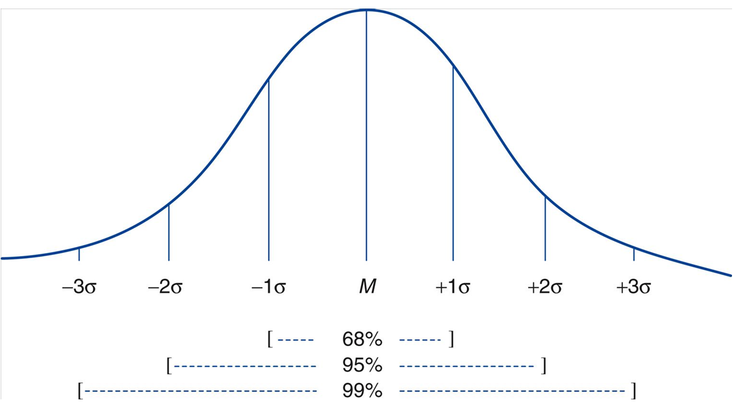
Standard Deviations in a Normal Curve
(“Average”)

Slide 5
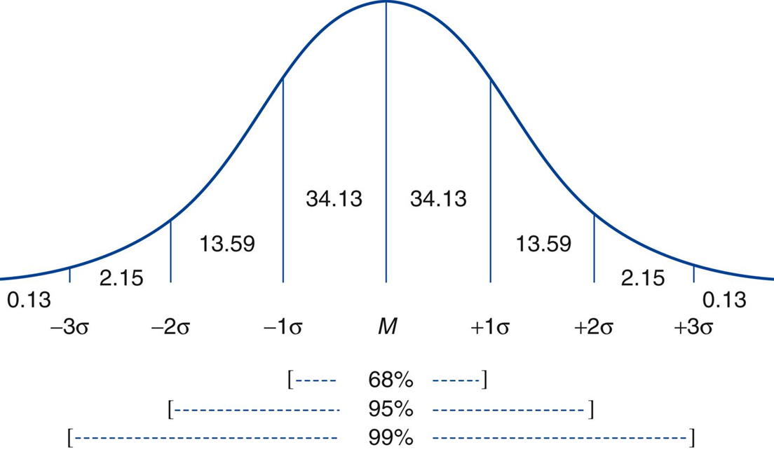
Normal Curve Percentages
Notes:
M = Mean of a Sample (not population..!). Otherwise the u sign mu…

Slide 6
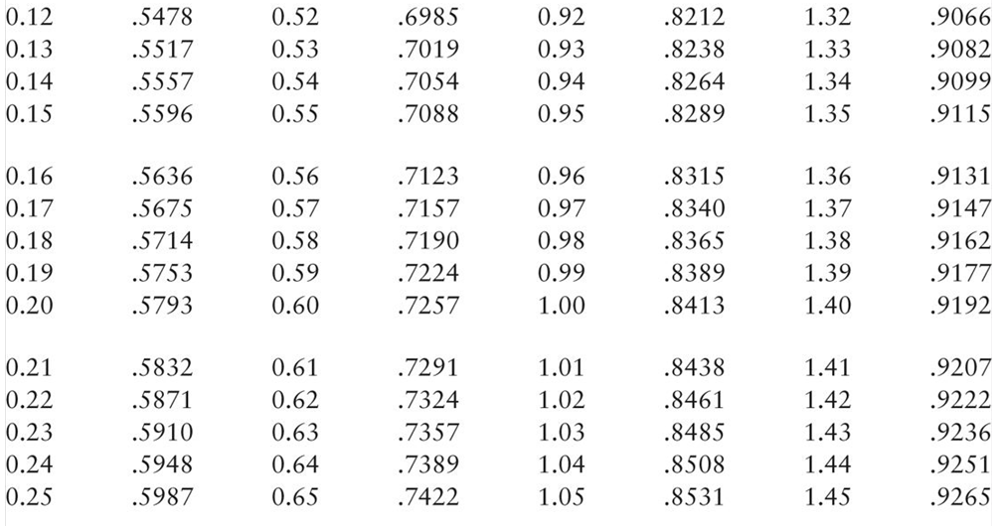

Understanding the “Z” tables in Appendix A
(Example One: Z score = 1.0)
Notes:
To get a z score, take the difference between the mean and the data point and divide the difference by the standard deviation. As a result, we can see where the data point lies on a normal curve.

Slide 7

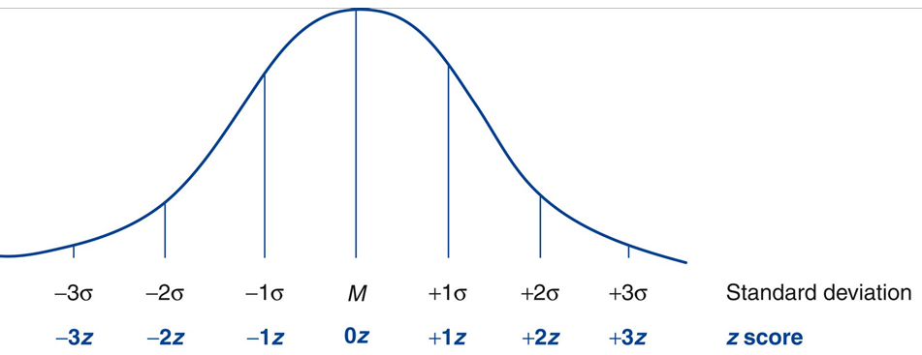
Comparing to the Z table in Appendix A
(Example One: Z score = 1.0)
Notes:
While there is only one mean on a distribution, there are hundreds of “Z” scores. One for every data point contributing to the distribution.

Slide 8
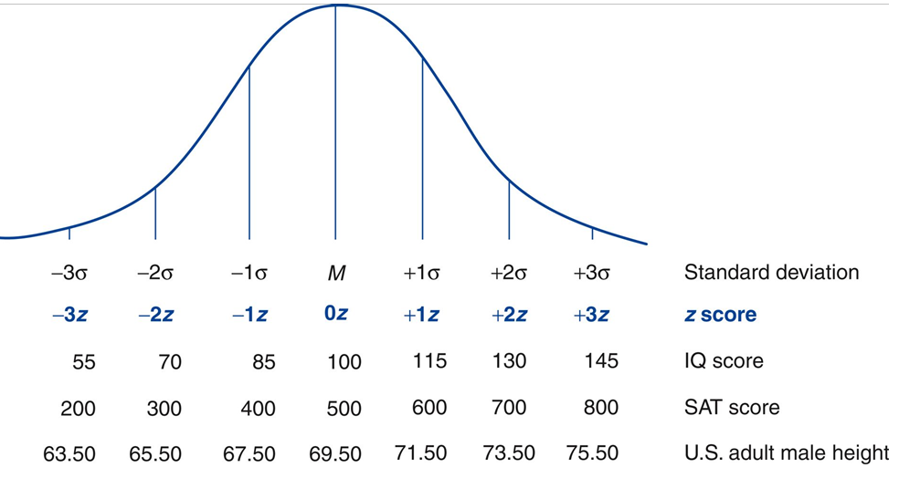
How Tall is …?
(Example One: Z score = 1.0)
Notes:
Every data point has a corresponding z score.
This chart is showing three databases. IQ Score, SAT Score, and US adult male height.

Slide 9
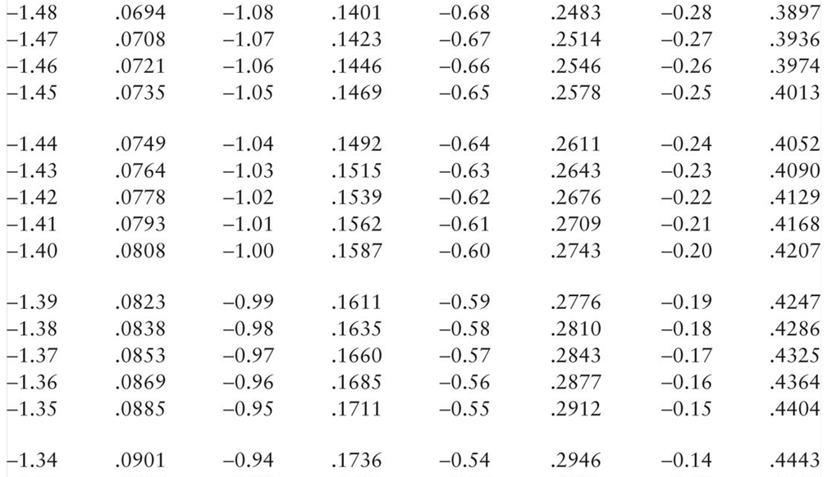

Still Trying to Understand the “Z” tables in Appendix A
(Example Two)

Slide 10

Z Score on the IQ Test…
Notes:
The formula for getting a z score is shown below. The letter symbols represent a sample. The Greek letters represent a population.
Z = (X – M)/SD or z = (X - µ)/σ

Slide 11

What’s Your Alpha Level = …?
A probability (p value) established before data are
collected to make a decision about
retaining or rejecting the null
p < .05 = reject p < .01 reject
Or
p > .05 = retain p > .01 retain

Slide 12
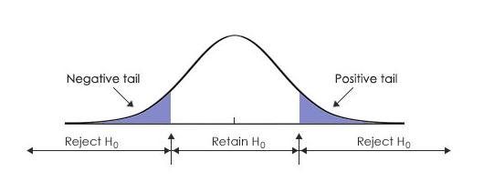

Are these Scores to be Retained or Rejected?
- 3.0
(Approximate)
3.0

Slide 13



My Fellow Passengers
(Reject or Retain)

